Slide 1

Microsoft Azure Administrator: Manage Data in Azure Storage
Working with Azure Import/Export Service
Michael Bender
Author evangelist - pluralsight
@michaelbender
Notes:
Managing data in Azure Storage can be tricky unless you have the right tools.
In this course, Microsoft Azure Administrator: Manage Data in Azure Storage, you’ll learn about the tools you need to know to manage your azure storage effectively.
I’m Michael Bender and I look forward to guiding you on your certification journey.

Slide 2

Course Coverage of Certification Objectives
Manage data in Azure Storage
Export from Azure job
Import into Azure job
Copy data by using AZCopy
Install and use Azure Storage Explorer
Full certification exam skills outline available at http://bit.ly/az104ms
Notes:
In this course, the focus is on managing data in azure , one of the 3 functional groupings of knowledge in the Monitor and Backup Azure Resources objective domain for the Microsoft Azure Administrator - AZ-104 exam.
First, you’ll learn how the Azure Import/Export Service works. This service is used to move large amounts of data into and out of Azure Blob Storage and Azure Files.
Next you’ll discover Azcopy, a CLI-based tool that is part of the Azure CLI toolset,. Azcopy allows you to move data from a file system to azure storage account, and between azure storage accounts.
Last, you’ll learn how to install and use Azure Storage Explorer, a GUI-based tool for managing all of your Azure Storage data.
Upon completion, you'll have all the knowledge you need for this area of the Az-104 certification exam AND be ready to manage your data in Azure Storage.
> Before we jump in

Slide 3
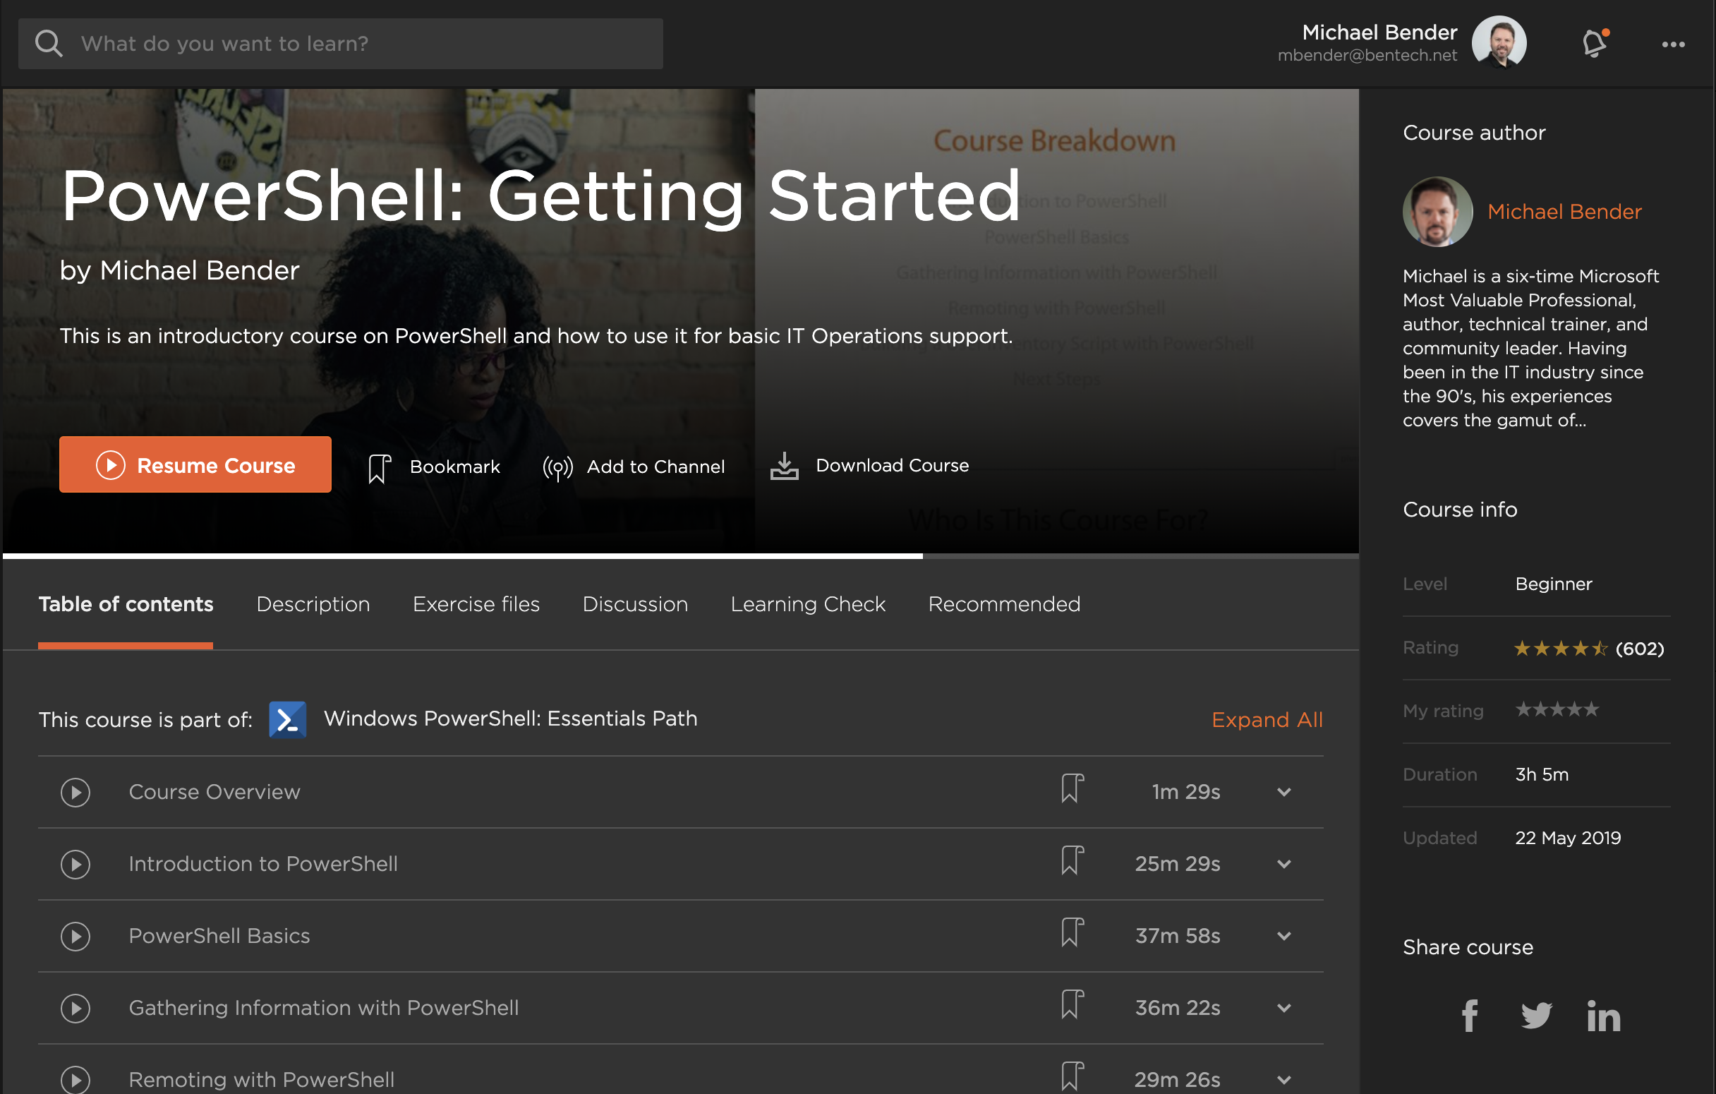
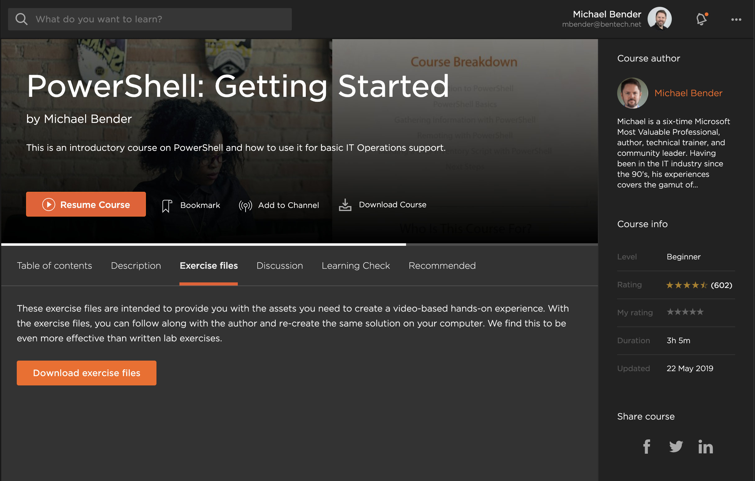
Exercise Files
Slides
Code
Links to Resources
Notes:
Before you jump,
I wanted to point out that this and every module has exercise files you can download from within the course page at Pluralsight.com. This download will include a PDF copy of the slides, any code and/or file assets used during the course for demos, and links to resources for deeper learning about the topics covered. This will be especially helpful as you are preparing the AZ-104 exam.
From the course page at Pluralsight, Just choose the Exercise file tab
And click on the download button to get all of the resources from this module. You will get a compressed .zip file that you can extract on your local computer.
Look for the read-me.md and course-resources.md files!
With that out of the way, let's get into the Azure Import Export Service!

Slide 4


Migrating Data into Azure
Over the wire
Ship physical media
Notes:
When it comes to getting your data to and from Azure, you really have two options driving the tool to use:
You can send the data ‘over the wire’ by use of the nternet.
This is great for small amounts of data and when you need to have the data in Azure ASAP. On the
However, large data sets will take time depending network speed.
The other option is shipping your data.
This is the best option when you have large amounts of data (like terabytes of data) that needs to get into Azure storage and it doesn’t need to be there the same day.

Slide 5



Data Management Tools
Azure Import/Export Service
AzCopy
Azure Storage Explorer
Notes:
To meet your needs, there are three tools you’ll learn about in this course.
First is the Azure Import/Export Service. This is an Azure service that allows you to copy data to physical drives (up to 10 at a time) for import into or export out of Azure Storage.
You want to use Import/Export when you have a large amount of data to move in Azure Blobs or Files or have to export a large amount of Azure Blobs.
For copying over the wire, you have two options:
First is AzCopy. This is a command line tool available on ?. It allows you to move data between a computer’s file system and a storage account, as well as from storage account to storage account in Azure.
Next is Azure Storage explorer. This is a desktop-installed management tool for administering your Azure Storage. While you can upload and download data with storage explorer, it gives you more admintrative capabilities like container creation, SAS Key creation, and more.
Now let’s dive into our first tool – Azure Import/Export Service.

Slide 6

Azure Import/Export Service
Securely import/export large amounts of data with physical drives
Create jobs in Azure Portal or Azure Resource Manager REST API
Import to Azure BlobStorage and Azure Files
Export to Azure BlobStorage
Supports General Purpose v1, v2, and BlobStorage storage accounts
Notes:
Azure Import/Export service works with Azure Storage, and is used to securely import and export large amounts of data by shipping disk drives to an Azure datacenter. When you see requests to move terabytes of data, Azure Import/Export is the most viable and cost effective option.
Azure Import/Export service allows data in and out of Azure Storage by creating jobs. Use Azure portal or Azure Resource Manager REST API to create jobs. Each job is associated with a single storage account.
The jobs can be import or export jobs.
An import job allows you to import data into Azure Blobs or Azure files whereas the export job allows data to be exported from Azure Blobs only.
For an import job, you ship drives containing your data.
When you create an export job, you ship empty drives to an Azure datacenter.
Currently, Azure Import/Export Service Supports General Purpose v1 & v2 storage, and BlobStorage storage accounts only. This is good to know for the exam AND when deploying your storage account resources.
TLDR:
Import works with Files and Blobs
Export is Blobs only
The Imports and Exports are achieved by creating a job in the Azure Portal.
What is required
Azure Files Max size is 5TB
Supports
Export – Blobs
Import – Blobs and File Shares
GPv1 (storage), GPv2 (storagev2),BlobStorage

Slide 7



Azure Import/Export use cases
Backups
Content distribution
Data recovery
Notes:
When looking at the use cases for Azure Import/Export, it is designed for Moving large data to azure cost effectively:
Scenarios including
Seeding Backups
Seeding Content Distribution across multiple sites or regions
And
Recovering large amounts of data from Azure to your on-premises datacenter.
The key to remember is use the Azure Import/Export service when you need to move Large amounts of data cost effectively, and the data doesn’t need to be moved across the Internet.

Slide 8



Azure Import Export Service Components
Azure Import/Export Service
WAImportExportTool
Drives
Notes:
Now lets take a look at the Azure Import/Export Service Components
First, is the actual Azure Import/Export Service. In the Azure Portal or via REST API, you create an job (import or export) for working with the data you need to move.
Next, is the WAImportExportTool. This is a command line tool, downloaded from Microsoft, that allows you to prepare and manage the drives being used in the Import and Export jobs
For hard drives, you can provide your own Solid State Drives or Hard Drives for Import/Export. The Size and # of drives will depend on the amount of data you have to import or export.
Another option is Azure Databox. This is a service where Microsoft provides you a piece of hardware, in 3 sizes, developed specifically for import/export tasks. More information on Azure Databox is in the course resources.
Drives
Your own SSD or HDD
Azure Databox
Drive Prepping
Driveset.csv
Dataset.csv

Slide 9





Importing Blobs and Files to Azure
Drives Prepped with WAImportExportTool and Bitlocker
Import Job Created
Drives shipped to Azure Datacenter
Processed drive data copied to storage account and ready for verification
Drive returned to customer
Notes:
Here’s how an import job works:
After determining data set for import and the number of drives needed is determined
You use file explorer or WAImportExportTool to copy data to your drives and create journal files for import. Then use bitlocker to encrypt the drives.
Drives need to be formatted as NTFS.
Note: You can use formatted or unformatted drives; They can be encrypted or unencrypted. But in the end, they will be NTFS and Bitlocker-encrypted. It all depends on how you want to go about the process.
Next, you’ll create the import job in the Azure Portal. This will require uploading the journal files for each drive, as well as providing shipping & receiving information.
Drives are then shipped to the Azure Datacenter. Address is provided during the import job creation process.
Upon receipt and processing, drive data is copied into the storage account specified during import job and is ready for customer verification. Always make sure to verify before deleting your on-premises data.
Last part is all drives are returned to customer
That is the process at a high level.
For the exam, the first two steps are the key information to know as well as knowing Import supports BlobStorage and FileStorage.
This is a super high level view of the process. You should definitely read the MS Docs on this process. Links are in the resource files for the course.

Slide 10



Exporting Blobs from Azure
Create export job in Azure Portal
Ship Drive to Datacenter
Export data copied to encrypted drive
Drive Shipped to customer
Unlock and verify drive with WAImportExport Unlock command
Notes:
When exporting data from Azure, it’s important to understand only Azure BlobStorage data is exportable. If Data is in another storage type, you’d need to migrate it to Blob storage
The process for exporting is straightforward.
Starting in the Azure Portal, you Create Export Job, and we’ll dive into this more in a minute.
Once the job is complete, Ship drive to Datacenter using the address your given in the export job.
When the drives are received and processed, your Blobs storage data will be copied to your drives and encrypted. Encrypted with bitlocker.
Upon completion, Drives are shipped back to the customer.
When you receive your drives, you’ll need to unlock and verify the drive. This is done with the WAImportExportTool unlock command. For the command, you will need the bitlocker key used to encrypt your drives. This is located in the Export job under the Encryption Blade.
Now you can access your data and perform any restores as needed.

Slide 11
Drive Preparation with WAImportExportTool
Notes:
Let’s take a deeper look at WAImportExportTool.exe, the tool used for preparing your drives..

Slide 12
WAImportExportTool
.\WAImportExport.exe PrepImport
/j:<JournalFile>
/id:<SessionId>
[/logdir:<LogDirectory>]
[/sk:<StorageAccountKey>] [/silentmode]
[/InitialDriveSet:<driveset.csv>]
/DataSet:<dataset.csv>
CLI tool run on 64-bit Windows Only!
Encryption, decryption and data copy
Creation of journal files
Determine number of drives needed for export job
2 versions for Azure Blobs (v1) and Azure Files (v2)
Notes:
As mentioned it is a CLI tool. In order to run the tool, you need a Windows 64-bit system. No MacOs or Linux support here.
Prepare Drives for Import jobs
This includes data copy, encryption of drives with bitlocker, and creation of journal files needed for Import jobs.
It can also be used when receiving export jobs to identified contents and number of drives in an export job.
It supports Azure Blobs and Azure Files, and comes in 2 versions:
Version 1 for import/export Azure Blob storage
Version 2 for import Azure Files
You’ll run the tool from the directory with the executable, and use the syntax above.

Slide 13
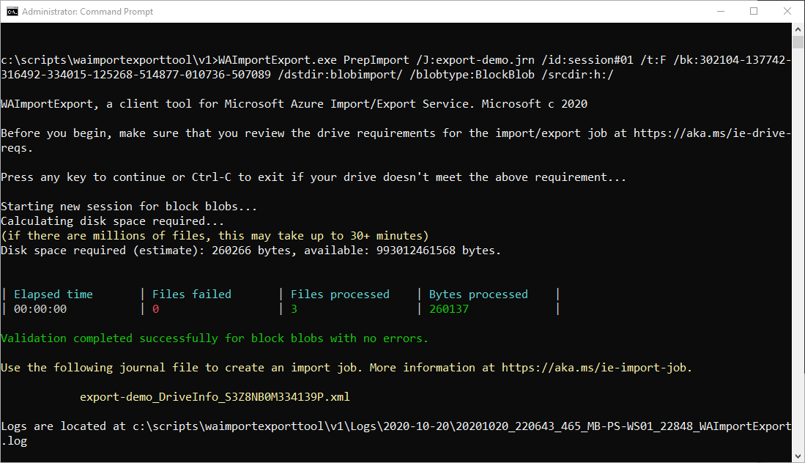
Preparing Drive for Import
Notes:
Here’s the command when run. It provides you disk space estimates along with other stats.
Depending on number of drives and amount of data, this process can take a while.

Slide 14
Copy and Prepare Data Drive for Azure File Import
.\WAImportExport.exe PrepImport
/j:JournalTest.jrn
/id:session#1
/sk:*******************
/InitialDriveSet:driveset-02.csv
/DataSet:dataset-02.csv
/logdir:C:\logs
Notes:
In this sample command, you are preparing a drive using driveset.csv and dataset.csv.
In this case, you enter the name of the journal, which will be written to the root directory of the WAImportExportTool location.
A session# is defined. If you need to add additional data later, you re-run the command with as session#2
The storage account key is added for access to the Files share.
Next, you define the driveset.csv and dataset.csv files. These define provide information about the data and drives used in the import job. While this example is for Azure Files, both can be used for Blobs or Files import jobs.
Last, you can add a logs directory.

Slide 15
Driveset.csv
DriveLetter,FormatOption,SilentOrPromptOnFormat,Encryption,ExistingBitLockerKey
H,Format,SilentMode,Encrypt,
List of disks mapped to drive letters
Can format drives with NTFS if unformatted
Can encrypt if drives are unencrypted
Notes:
Driveset.csv is a CSV file that contains the list of disks to which the drive letters are mapped so that the tool can correctly pick the list of disks to be prepared. If the data size is greater than a single disk size, the WAImportExport tool will distribute the data across multiple disks enlisted in this CSV file in an optimized way.
As mentioned, you don’t need to format or encrypt the drives before running. However, you’ll need to define a driveset.csv file to format or encrypt as need. Remember, the end state will be a bitlocker-encrypted NTFS drive.
Above is a sample driveset.csv file. The first line is a typical CSV header row followed by data rows.
In this case a drive, H, requires formatting and encryption.

Slide 16
Driveset.csv
DriveLetter,FormatOption,SilentOrPromptOnFormat,Encryption,ExistingBitLockerKey
G,AlreadyFormatted,SilentMode,AlreadyEncrypted,060456-014509-132033-080300-252615-584177-672089-411631
List of disks mapped to drive letters
Can encrypt if drives are unencrypted
Notes:
For encrypted drives, you specify the bitlocker key in the CSV file for each drive as seen here.

Slide 17
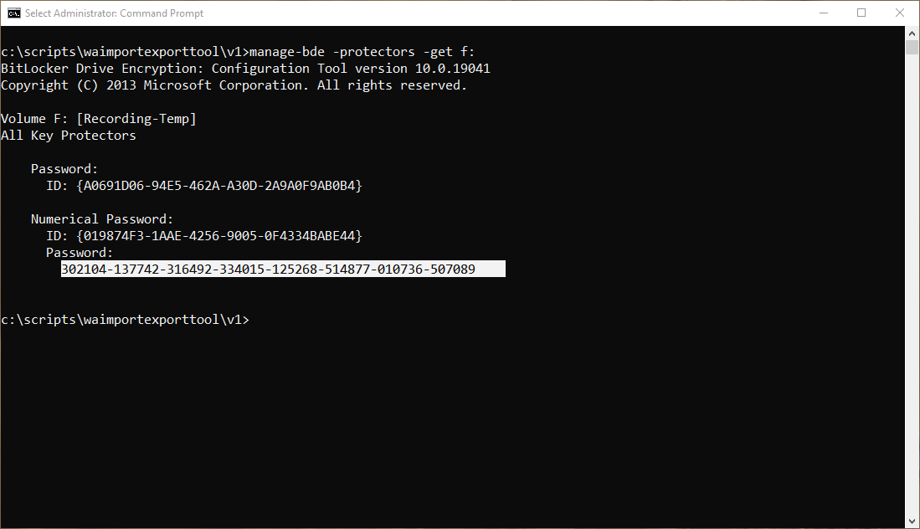
Preparing Drive for Import
Bitlocker Key
Notes:
If you need the bitlocker key for an already encrypted drive, use manage bde as seen here. Then just add the key to your driveset.csv file.

Slide 18
Dataset.csv
BasePath,DstBlobPathOrPrefix,BlobType,Disposition,MetadataFile,PropertiesFile
F:\Video\,video/,BlockBlob,rename,None,None
F:\Photo\,photo/,BlockBlob,rename,None,None
\\myshare\john\music\,music/,BlockBlob,rename,None,None
List of files and/or directories for import
Local files mapped to Azure Storage endpoint
Notes:
Dataset CSV file is a list of directories and/or a list of files to be copied to target drives. The first step to creating an import job is to determine which directories and files you are going to import. This list is added into the CSV file
For each directory or file to be imported, you must identify a destination virtual directory or blob in the Azure Blob service. You will use these targets as inputs to the WAImportExport tool. Directories should be delimited with the forward slash character "/“ forward slash.
Note how you can combine multiple drive locations as well as shared drive locations.
Notice you don’t have to include the Storage Account name because that is defined in the Import Job creation process.
Dataset and Driveset can be used with import jobs for Blobs and Files.

Slide 19
Copy and Prepare Data Drive for Azure Blob Import
./WAImportExport.exe PrepImport
/j:<journal file name>
/id:<session number>
/t:<target drive letter>
/bk:<BitLocker key>
/srcdir:<source drive letter>:\
/dstdir:<Container name>/
/blobtype:<BlockBlob or PageBlob> /skipwrite
Notes:
Now we have another example where you are import data, but not using Driveset.csv or dataset.csv.
This will assume you have a drive already encrypted with bitlocker.

Slide 20
Copy and Prepare Data Drive for Azure Blob Import
./WAImportExport.exe PrepImport
/j:export-journal.jrn
/id:session#1
/t:H
/bk:<64-bit BitLocker Key>
/srcdir:Y:\
/dstdir:sablobstorage001.blob.core.windows.net/blobimport
/blobtype:BlockBlob
Notes:
In this example,
You specify the name of the journal file and session ID.
Then you include the Target directory, or the drive you will ship.
Then you add your bitlocker key, and define the source directory of your data.
Define the storage account location in Azure and the blobtype.

Slide 21
Import Job in the Azure Portal Walkthrough
Notes:
Let’s walk through the Export job in the Azure Portal.

Slide 22
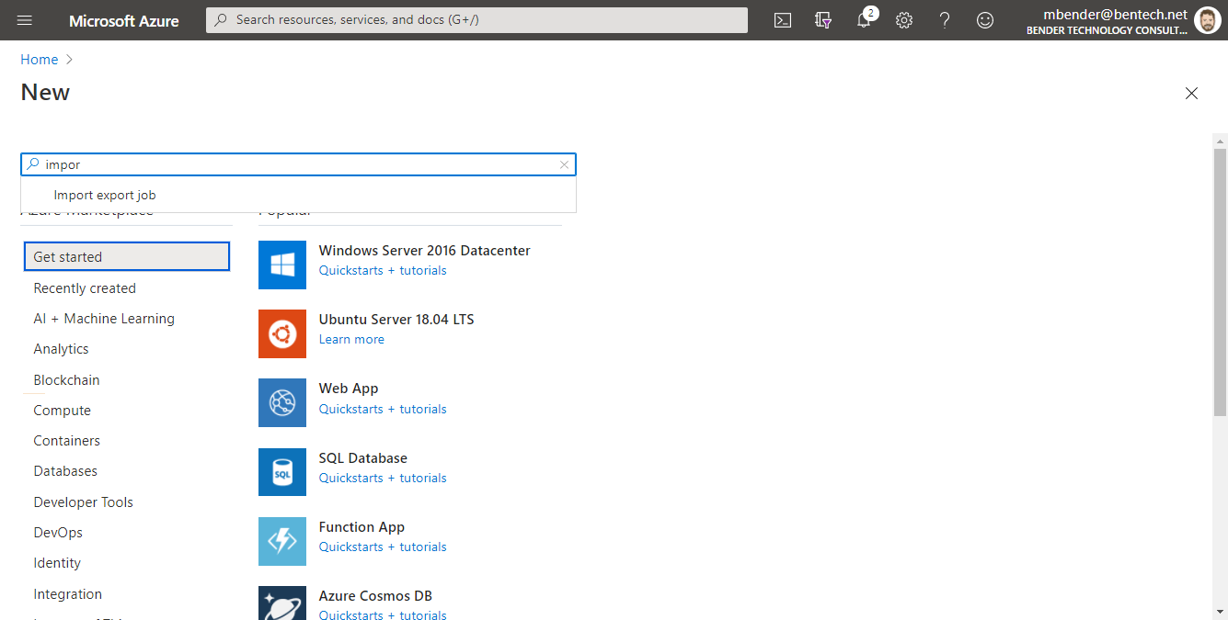
Create Import Job in Azure Portal
Notes:
To begin creating an import job, search for ‘import export job’ from the marketplace and click ‘create’.

Slide 23
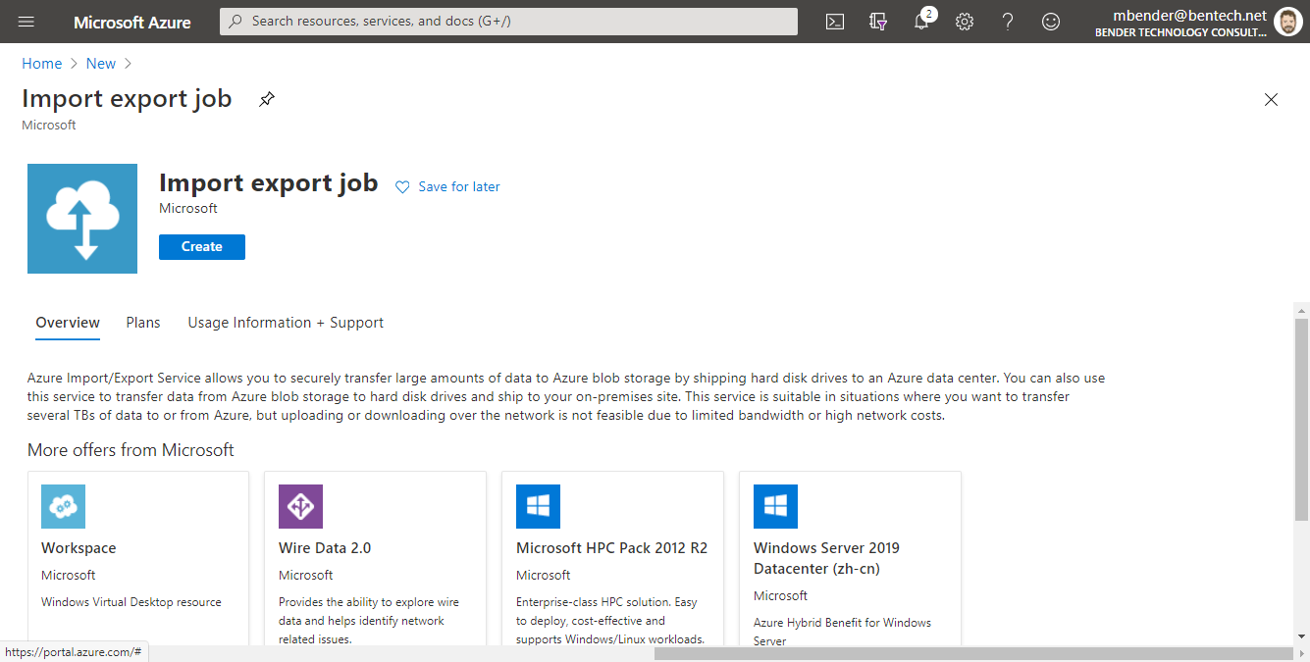
Create Import Job in Azure Portal
Notes:
To begin creating an import job, search for ‘import export job’ from the marketplace and click ‘create’.

Slide 24
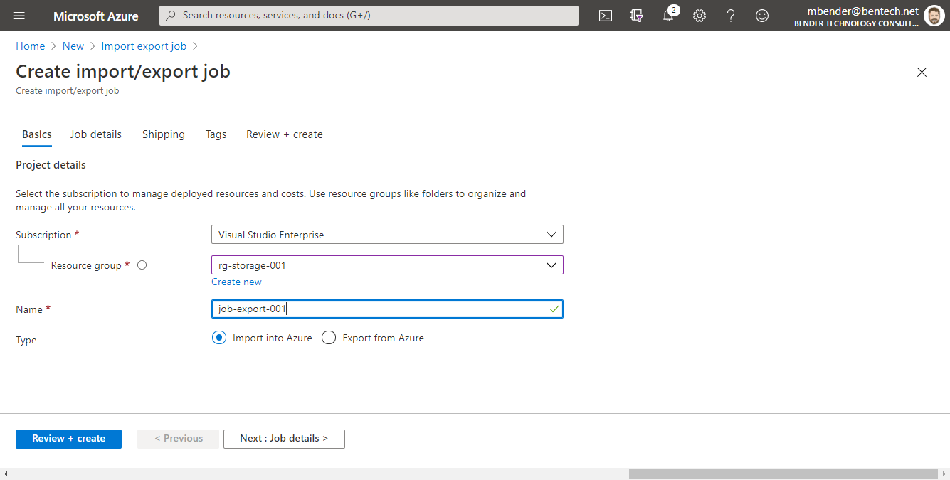
Create Import Job in Azure Portal
Notes:
In the create import/export job window, starting on the basics tab, you enter
Subscription,
Resource group
Name of the import job resource and location for the resource
> Click on the Job Details tab or Next: Job Details button
Insert Callout

Slide 25
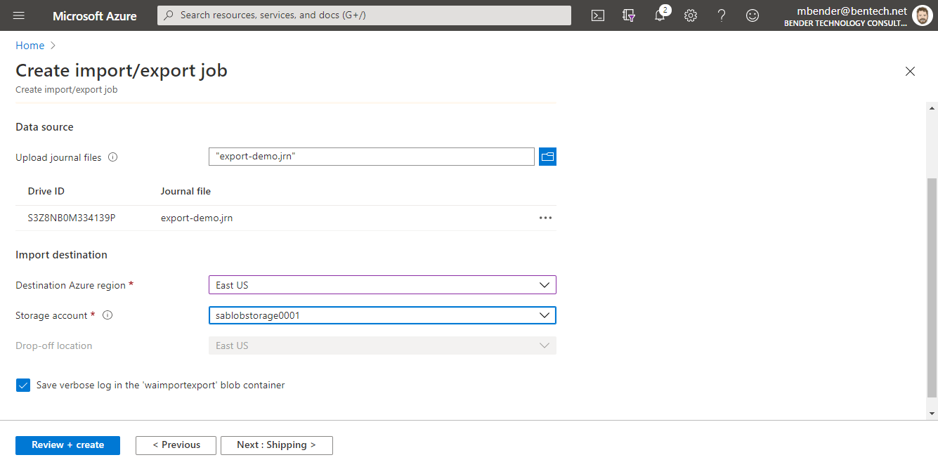
Create Import Job in Azure Portal
Notes:
On the job details page, you’ll upload the journal files created during the disk prep process.
Then Select the destination Azure Region and the target storage account.
> Choose the Shipping tab or Next: Shipping Button

Slide 26
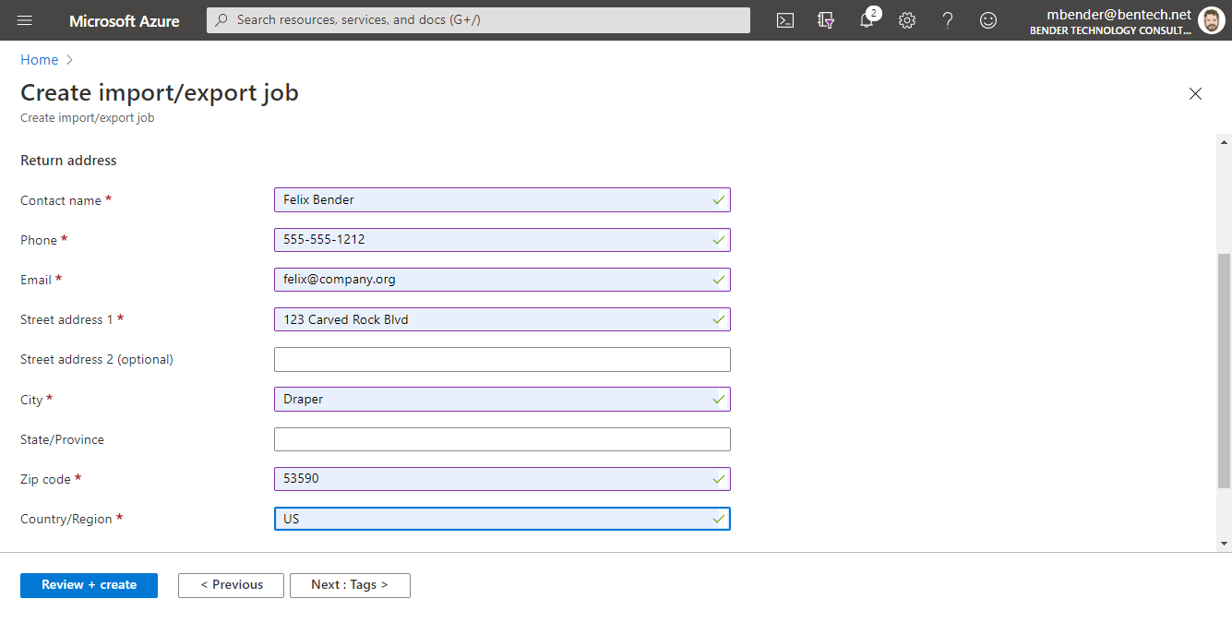
Create Import Job in Azure Portal
Notes:
Choose the Shipping tab,
Enter all your shipping and receiving information.
For the shippers, check docs.Microsoft.com for the approved US-based and international shippers. > Click Tags is you need to add tags, or click the Review + Create tab /button to review & begin creating the job

Slide 27
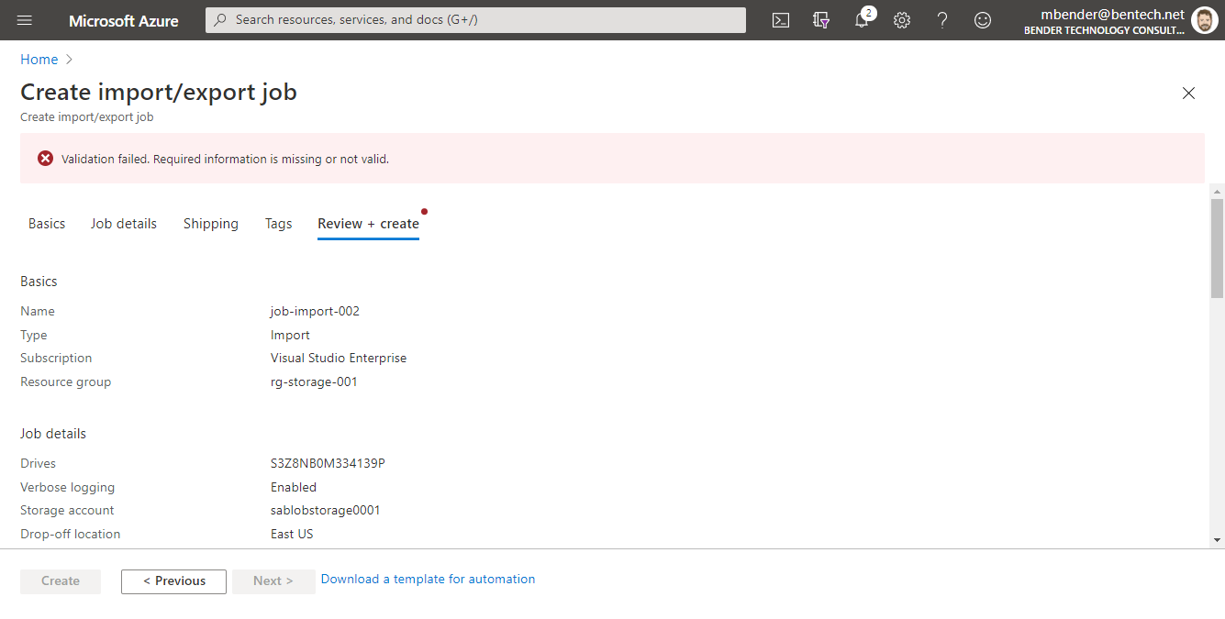
Create Import Job in Azure Portal
Notes:
Review the information & verify it is correct.

Slide 28
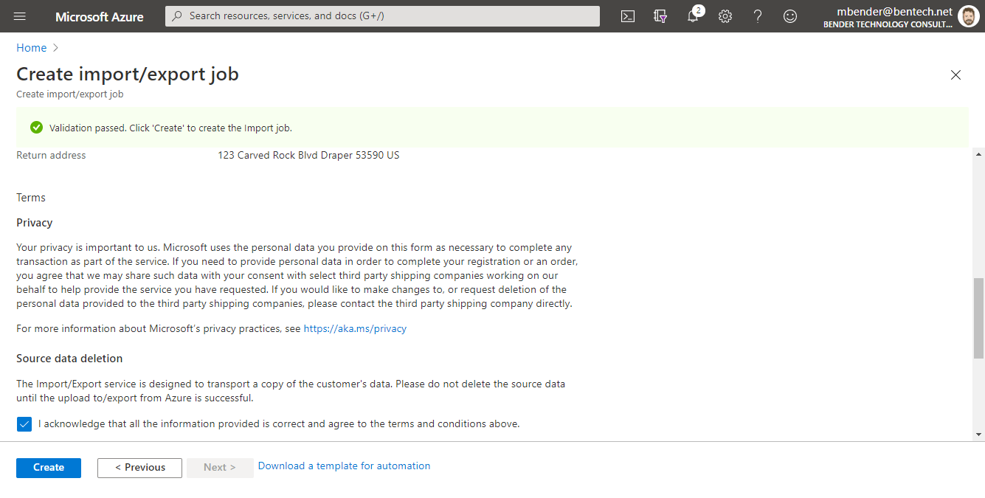
Create Import Job in Azure Portal
Notes:
Scroll down the screen, review the privacy information and Source data deletion information.
Check the Acknowledgement that data is correct and you agree to terms and conditions.

Slide 29
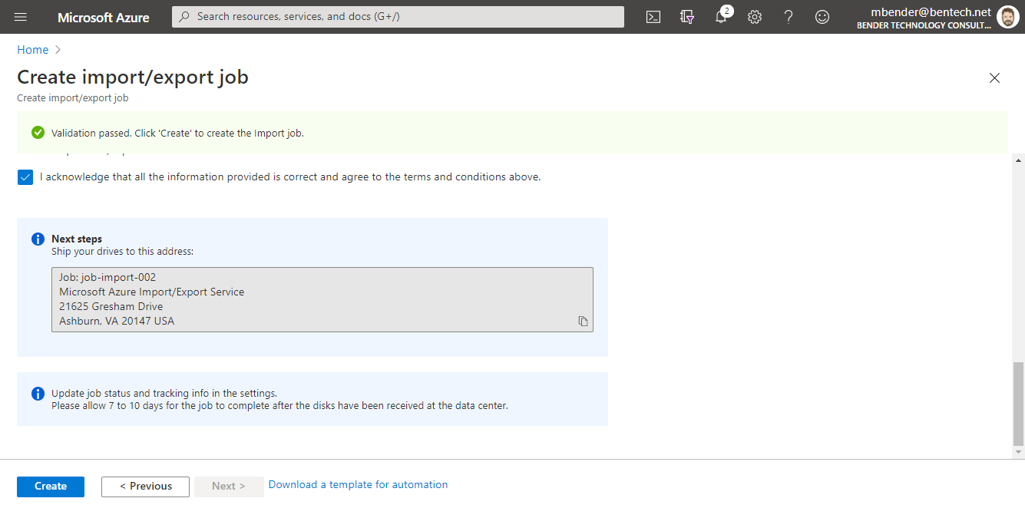
Create Import Job in Azure Portal
Notes:
Make note of the shipping address for your drives and click ‘Create’ When ready.

Slide 30
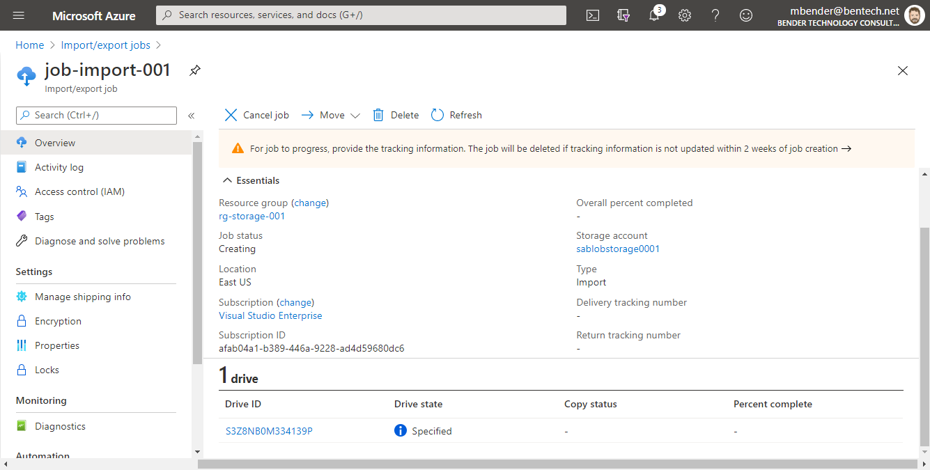
Verify Job Status
Notes:
Once the job is completed,
Verifying the job status can be done from the Overview tab of the import job. This gives you a view of the job progress, tracking information for shipping and receiving, as well as copying status with Overall percent completed displayed.
Notice the job status of Creating and this will be updated throughout the process.
Also, notice at the top you need to enter tracking information into the job otherwise the job will be deleted in 2 weeks.
Each drive is listed and you can click in to each drive for it’s copy status into Azure Storage.

Slide 31
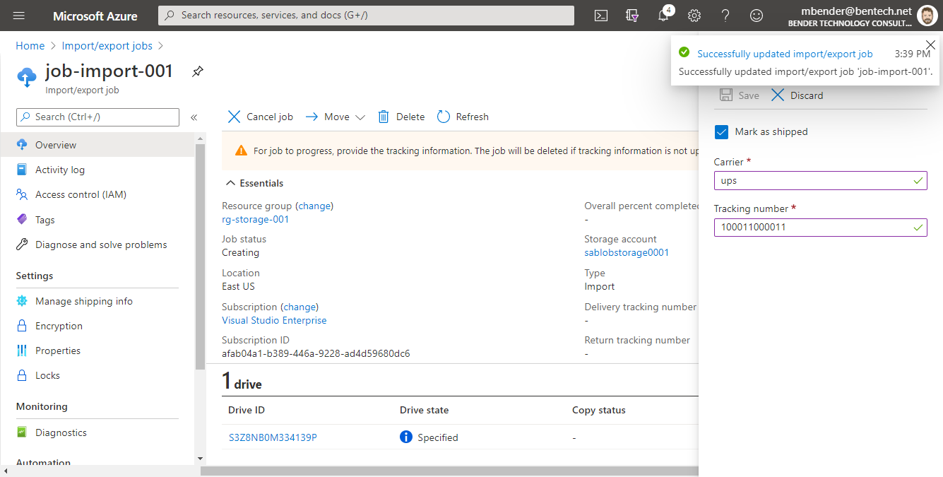
Verify Job Status
Notes:
Once the job is completed,
Verifying the job status can be done from the Overview tab of the import job. This gives you a view of the job progress, tracking information for shipping and receiving, as well as copying status with Overall percent completed displayed.
Notice the job status of Creating and this will be updated throughout the process.
Also, notice at the top you need to enter tracking information into the job otherwise the job will be deleted in 2 weeks.
Each drive is listed and you can click in to each drive for it’s copy status into Azure Storage.

Slide 32
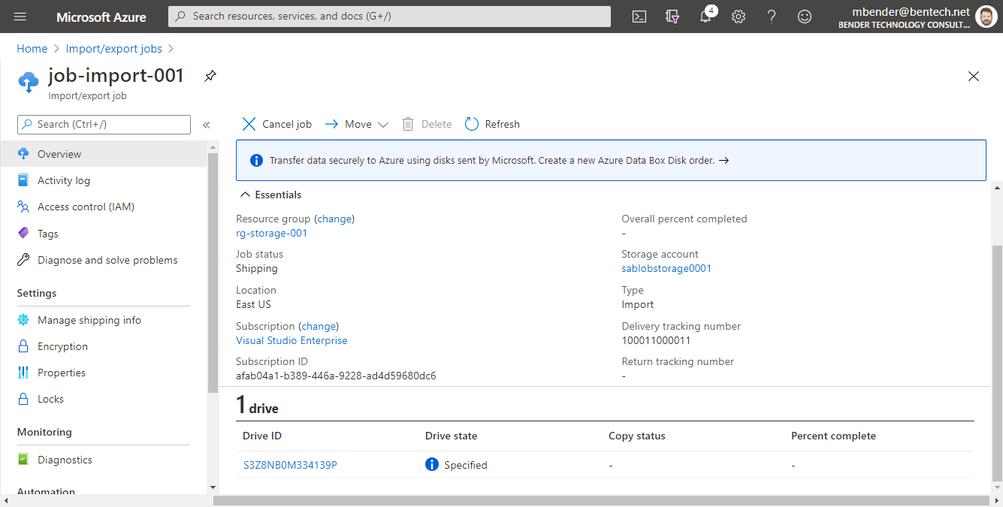
Verify Job Status
Notes:
Once the job is completed,
Verifying the job status can be done from the Overview tab of the import job. This gives you a view of the job progress, tracking information for shipping and receiving, as well as copying status with Overall percent completed displayed.
Notice the job status of Creating and this will be updated throughout the process.
Also, notice at the top you need to enter tracking information into the job otherwise the job will be deleted in 2 weeks.
Each drive is listed and you can click in to each drive for it’s copy status into Azure Storage.

Slide 33
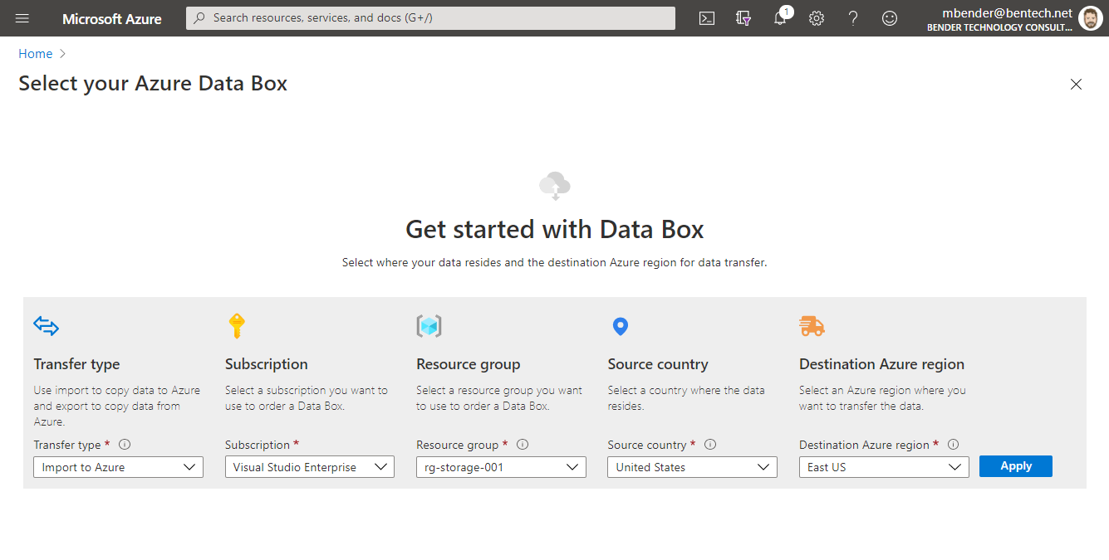
Verify Job Status
Notes:
Once the job is completed,
Verifying the job status can be done from the Overview tab of the import job. This gives you a view of the job progress, tracking information for shipping and receiving, as well as copying status with Overall percent completed displayed.
Notice the job status of Creating and this will be updated throughout the process.
Also, notice at the top you need to enter tracking information into the job otherwise the job will be deleted in 2 weeks.
Each drive is listed and you can click in to each drive for it’s copy status into Azure Storage.

Slide 34
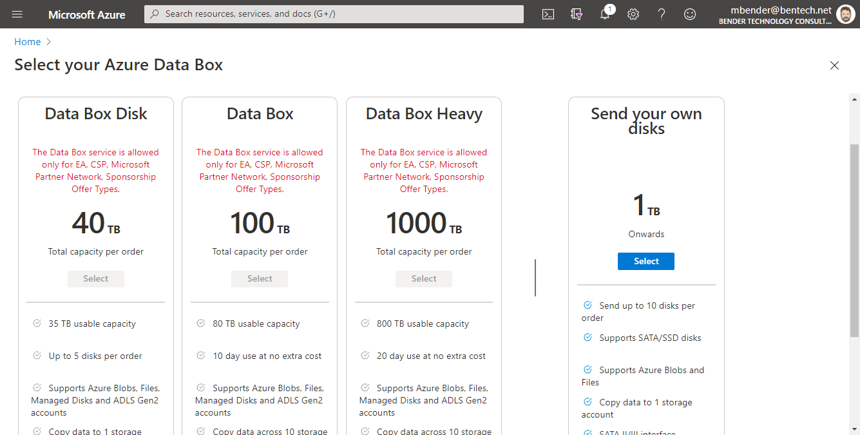
Verify Job Status
Notes:
Once the job is completed,
Verifying the job status can be done from the Overview tab of the import job. This gives you a view of the job progress, tracking information for shipping and receiving, as well as copying status with Overall percent completed displayed.
Notice the job status of Creating and this will be updated throughout the process.
Also, notice at the top you need to enter tracking information into the job otherwise the job will be deleted in 2 weeks.
Each drive is listed and you can click in to each drive for it’s copy status into Azure Storage.

Slide 35
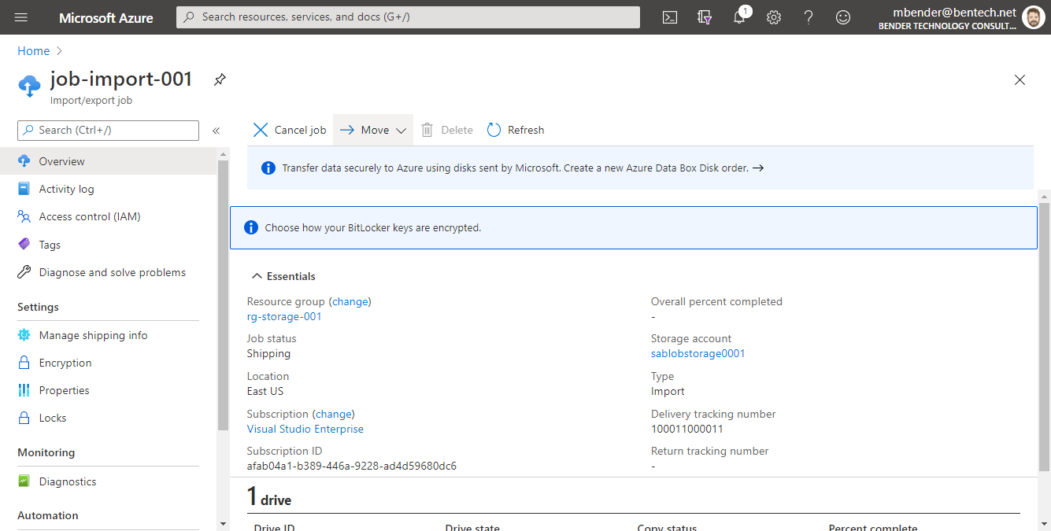
Verify Job Status
Notes:
Once the job is completed,
Verifying the job status can be done from the Overview tab of the import job. This gives you a view of the job progress, tracking information for shipping and receiving, as well as copying status with Overall percent completed displayed.
Notice the job status of Creating and this will be updated throughout the process.
Also, notice at the top you need to enter tracking information into the job otherwise the job will be deleted in 2 weeks.
Each drive is listed and you can click in to each drive for it’s copy status into Azure Storage.

Slide 36
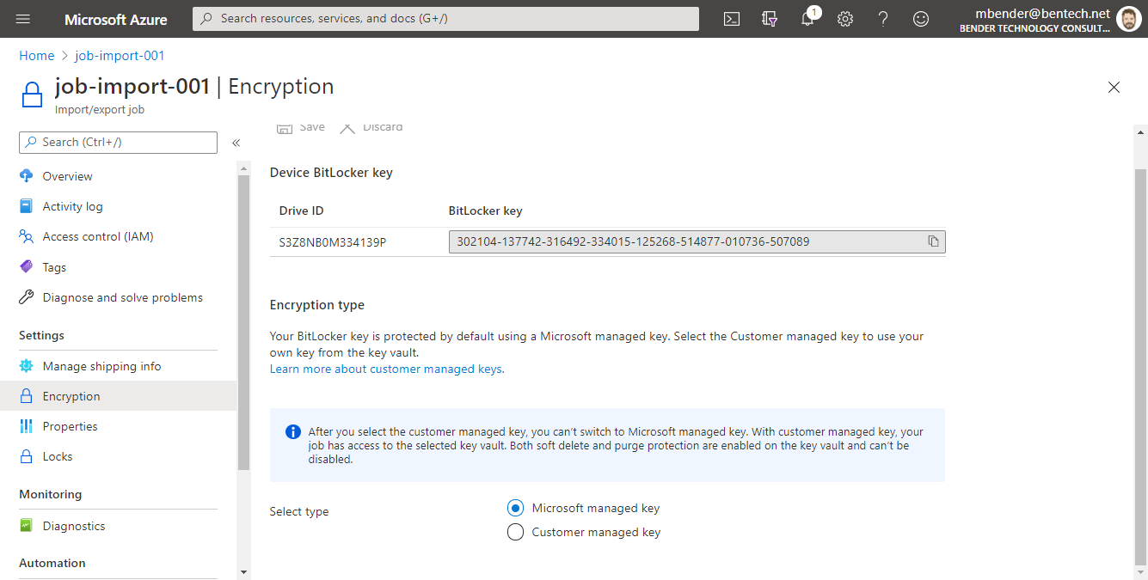
Verify Job Status
Notes:
Once the job is completed,
Verifying the job status can be done from the Overview tab of the import job. This gives you a view of the job progress, tracking information for shipping and receiving, as well as copying status with Overall percent completed displayed.
Notice the job status of Creating and this will be updated throughout the process.
Also, notice at the top you need to enter tracking information into the job otherwise the job will be deleted in 2 weeks.
Each drive is listed and you can click in to each drive for it’s copy status into Azure Storage.

Slide 37
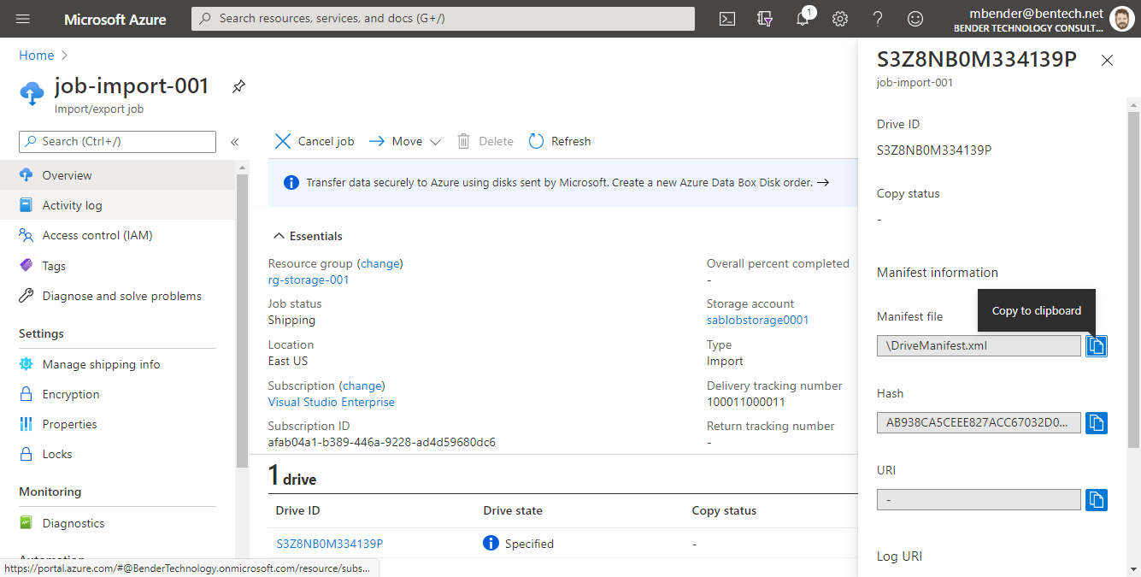
Verify Job Status
Notes:
Once the job is completed,
Verifying the job status can be done from the Overview tab of the import job. This gives you a view of the job progress, tracking information for shipping and receiving, as well as copying status with Overall percent completed displayed.
Notice the job status of Creating and this will be updated throughout the process.
Also, notice at the top you need to enter tracking information into the job otherwise the job will be deleted in 2 weeks.
Each drive is listed and you can click in to each drive for it’s copy status into Azure Storage.

Slide 38
Export Job in the Azure Portal Walkthrough
Notes:
Let’s walk through the Export job in the Azure Portal.

Slide 39
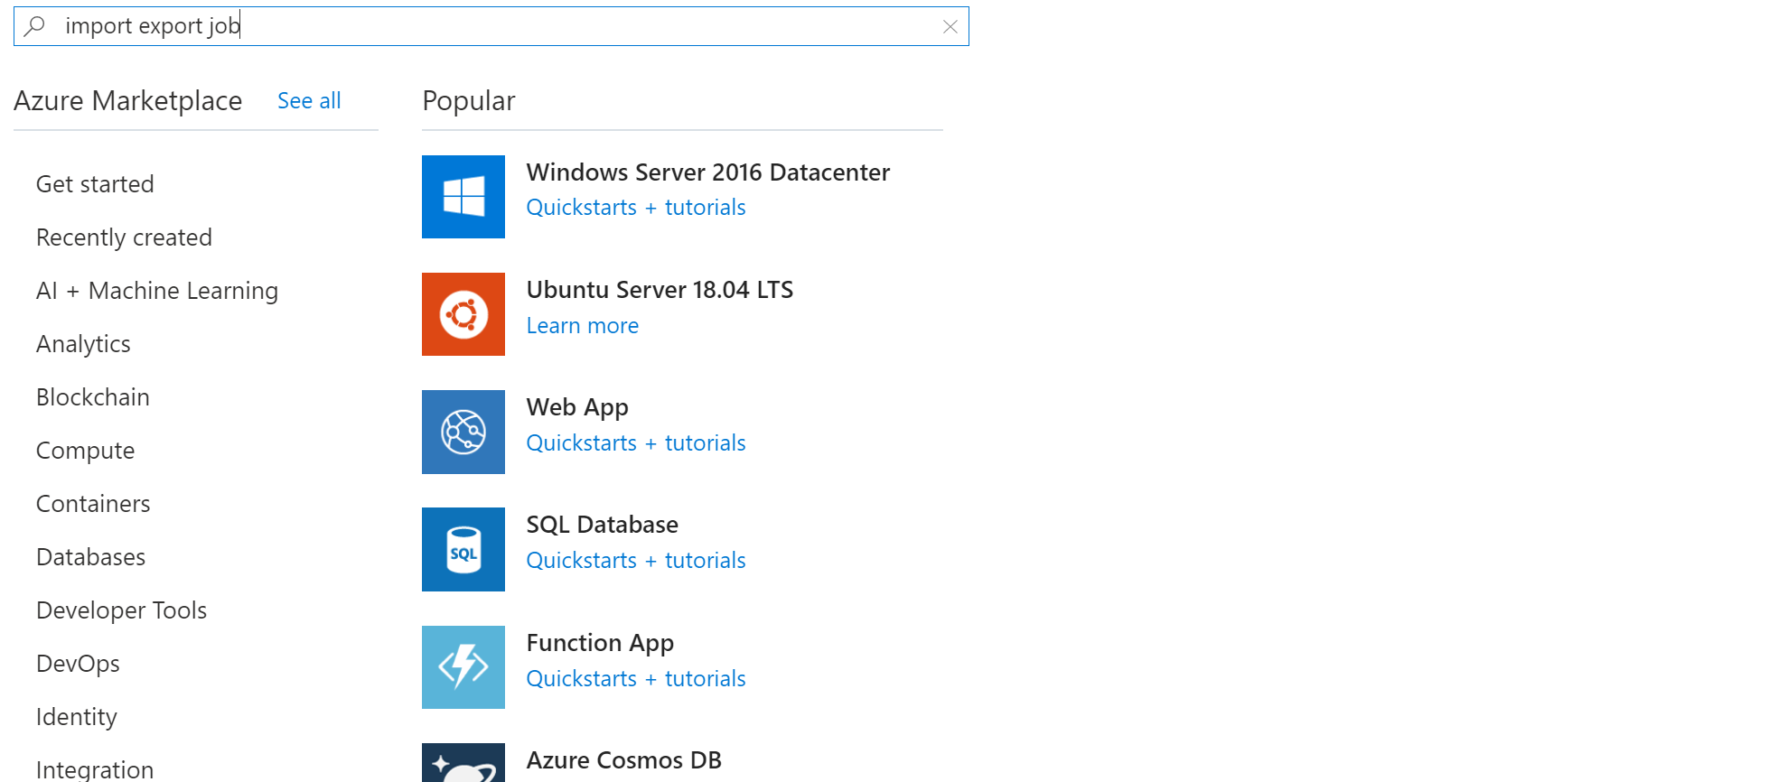
Create Export Job in Azure Portal
Notes:
To begin creating an export job, search for ‘import export job’ from the marketplace in the Azure Portal
> and click ‘create’ in the import job window

Slide 40
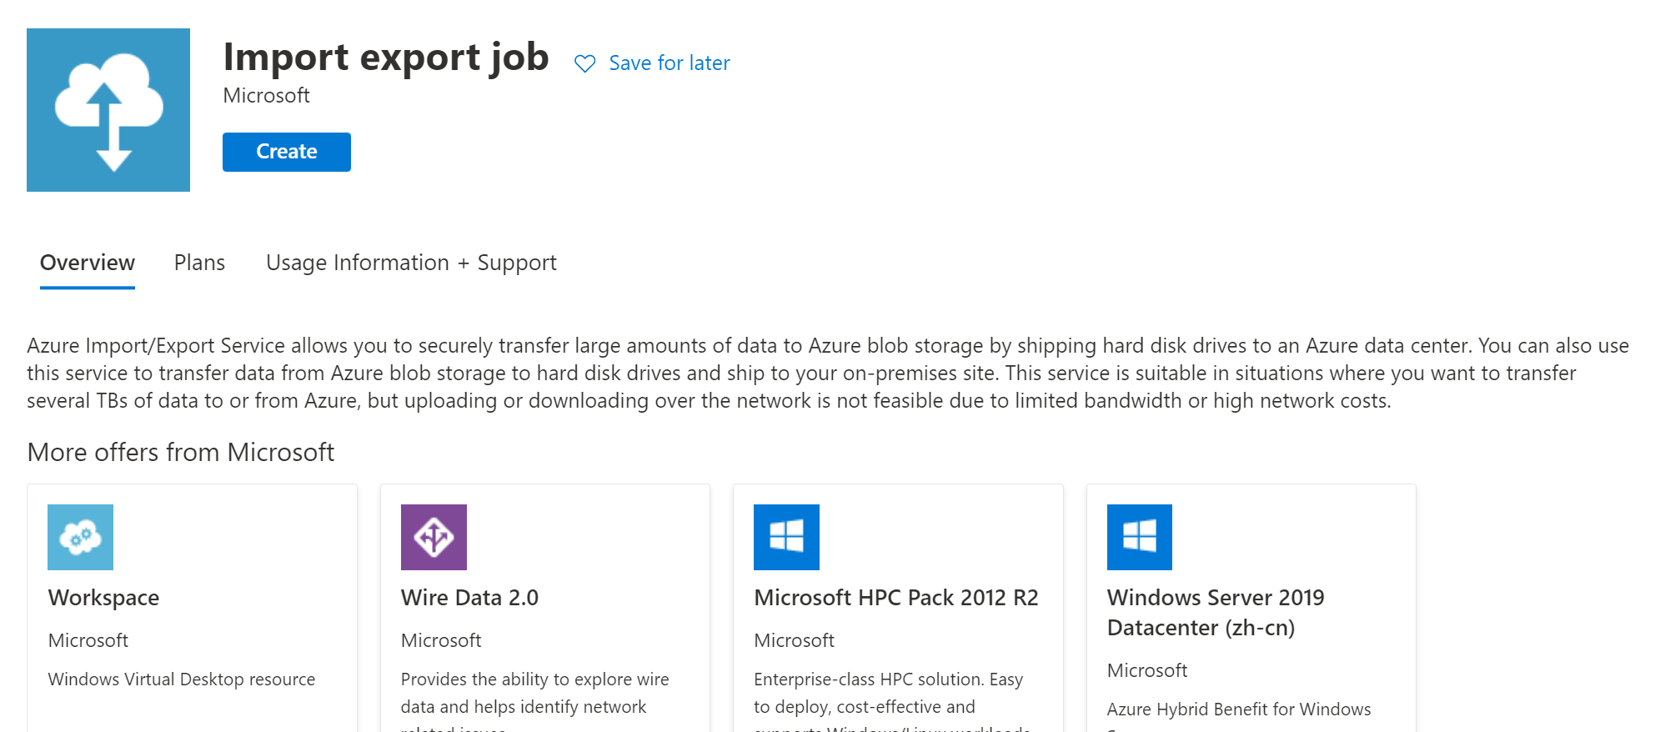
Create Export Job in Azure Portal
Notes:
> and click ‘create’ in the import job window

Slide 41
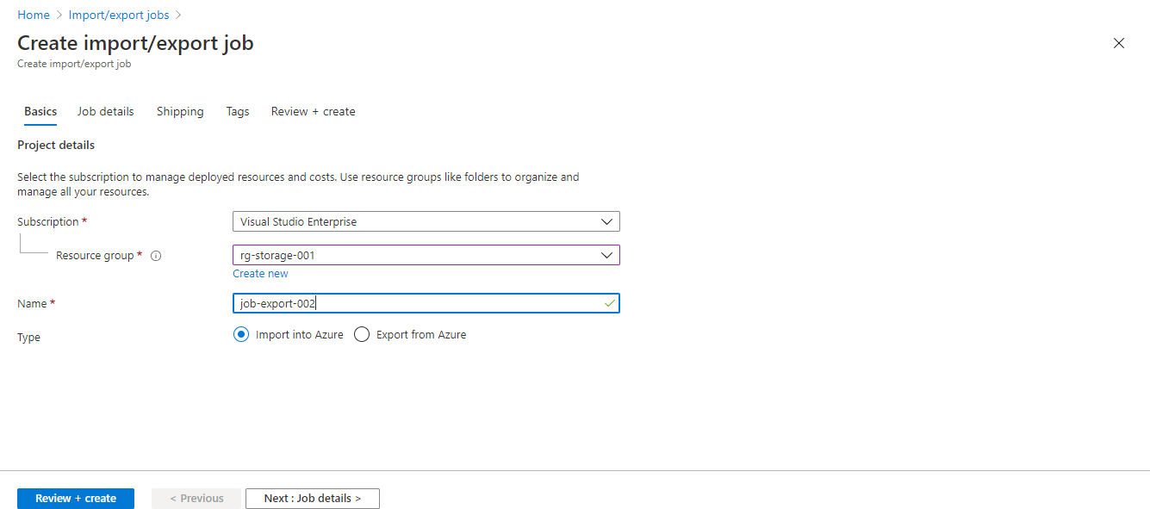
Create Export Job in Azure Portal
Notes:
In the Create Import/Export Window, enter the name of your job and choose the ‘Export from Azure’ radio button,
> Click Job details tab/button

Slide 42
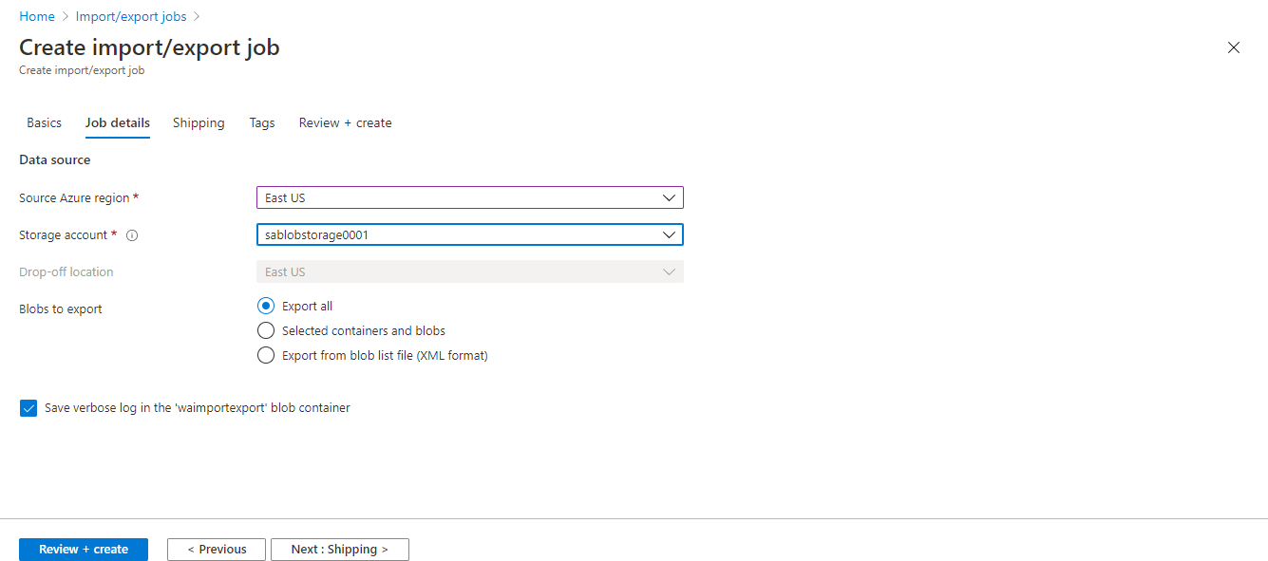
Create Export Job in Azure Portal
Notes:
Click Job details tab/button.
Now enter the source Azure region and storage account.
Choose how you want to export. You options include
all blobs in the storage account
Select Containers and Blobs
Export from blov list file (XML format). This allows you to create a blob list file with xml
By default, a lob file will be created in the storage account.
>Click the shipping tab to enter your shipping information.

Slide 43
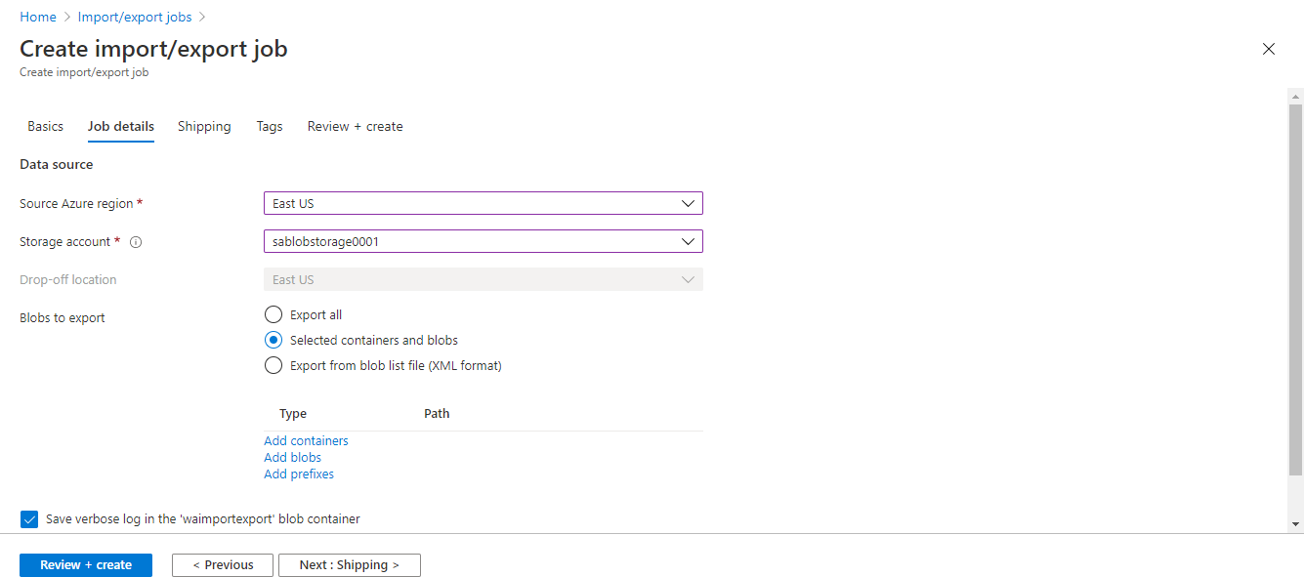
Create Export Job in Azure Portal
Notes:
Click Job details tab/button.
Now enter the source Azure region and storage account.
Choose how you want to export. You options include
all blobs in the storage account
Select Containers and Blobs
Export from blov list file (XML format). This allows you to create a blob list file with xml
By default, a lob file will be created in the storage account.
>Click the shipping tab to enter your shipping information.

Slide 44
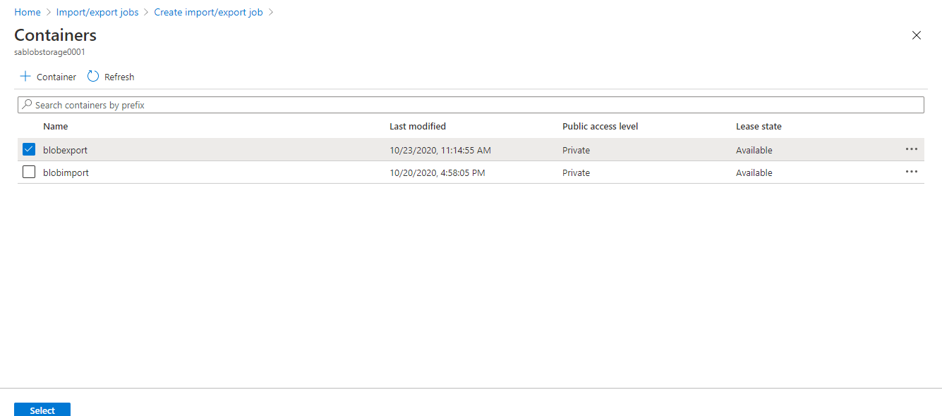
Create Export Job in Azure Portal
Notes:
Click Job details tab/button.
Now enter the source Azure region and storage account.
Choose how you want to export. You options include
all blobs in the storage account
Select Containers and Blobs
Export from blov list file (XML format). This allows you to create a blob list file with xml
By default, a lob file will be created in the storage account.
>Click the shipping tab to enter your shipping information.

Slide 45

Create Export Job in Azure Portal
Notes:
Click Job details tab/button.
Now enter the source Azure region and storage account.
Choose how you want to export. You options include
all blobs in the storage account
Select Containers and Blobs
Export from blov list file (XML format). This allows you to create a blob list file with xml
By default, a lob file will be created in the storage account.
>Click the shipping tab to enter your shipping information.

Slide 46
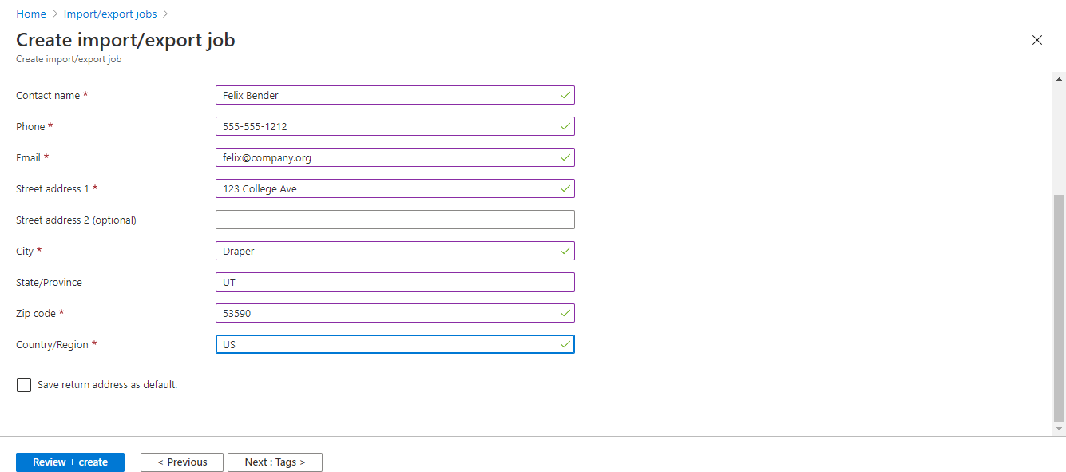
Create Export Job in Azure Portal
Notes:
>Click the shipping tab to enter your shipping information.
Enter tags if need, or click ‘Review and Create` to begin your job review and create the job.

Slide 47
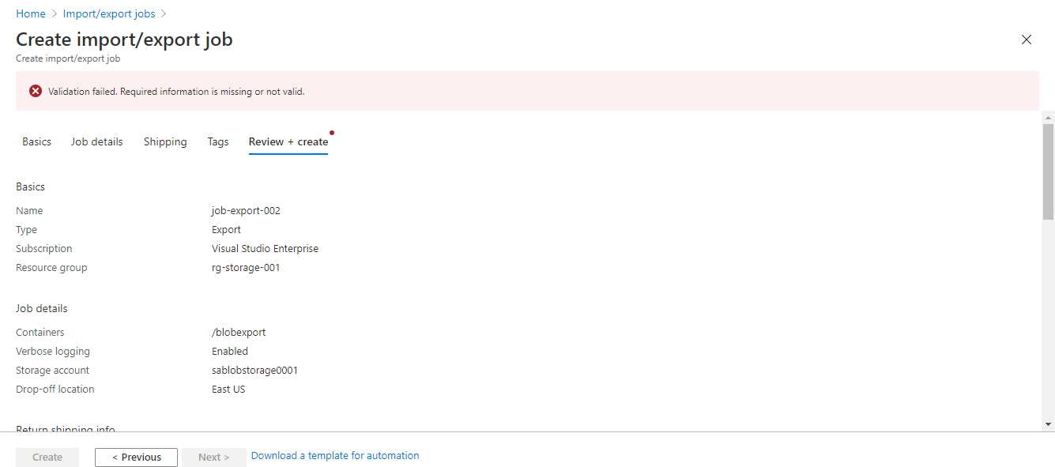
Create Export Job in Azure Portal
Notes:
Review the information & verify it is correct.
> Scroll down the screen

Slide 48
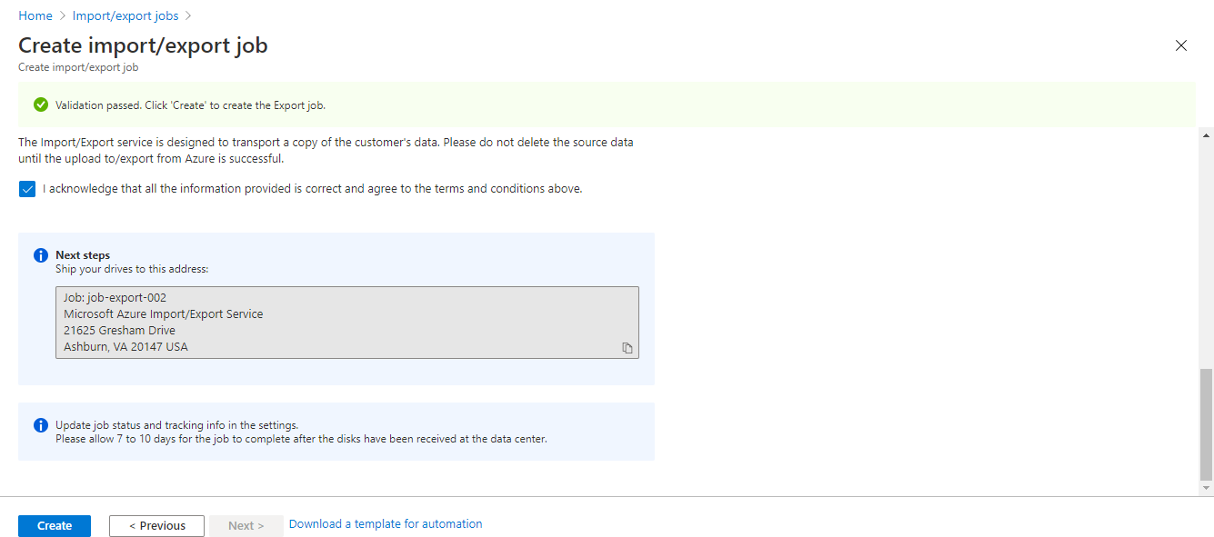
Create Export Job in Azure Portal
Notes:
>Scroll down the screen, review the privacy information and Source data deletion information.
Check the Acknowledgement that data is correct and you agree to terms and conditions.
Make note of the shipping address for your drives and click ‘Create’ When ready.
At this point, you ship off your blank drives, wait for Microsoft to process the drives, copy the data, and send the drives back to you.

Slide 49
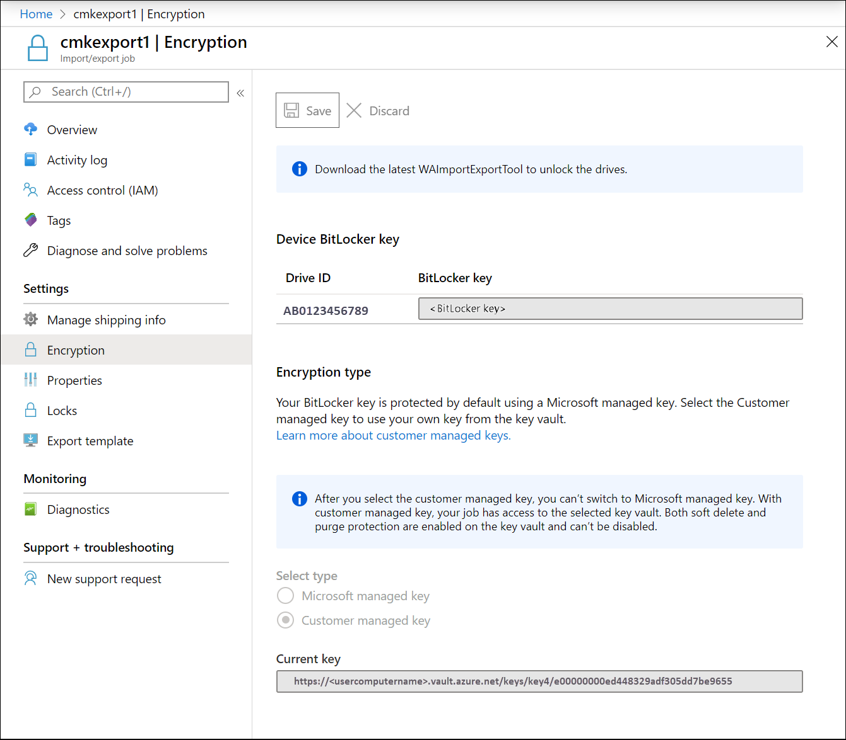
Retrieving BitLocker Key from Azure Portal
Notes:
Once you’ve received your drives back from Microsoft, you want to access your data, right?
To do that you’ll need the BitLocker key used to encrypt the disks at the Azure Data center.
From the Encryption blade of your Export job in the Azure Portal, you would copy the current key for each drive
>And then use WAImportExport to unlock the drive

Slide 50
Managing Data with Azure Storage Explorer and AZcopy
Michael Bender
Author evangelist - pluralsight
@michaelbender
Notes:
Now let’s look at two additional tools for managing your Azure Storage – AzCopy and Azure Storage Explorer.
You’ll start off learning how to install AzCopy, a command line utility, and use it to copy files and blobs to and in Azure.
Next you’ll discover storage management with Azure Storage Explorer, a desktop application,

Slide 51
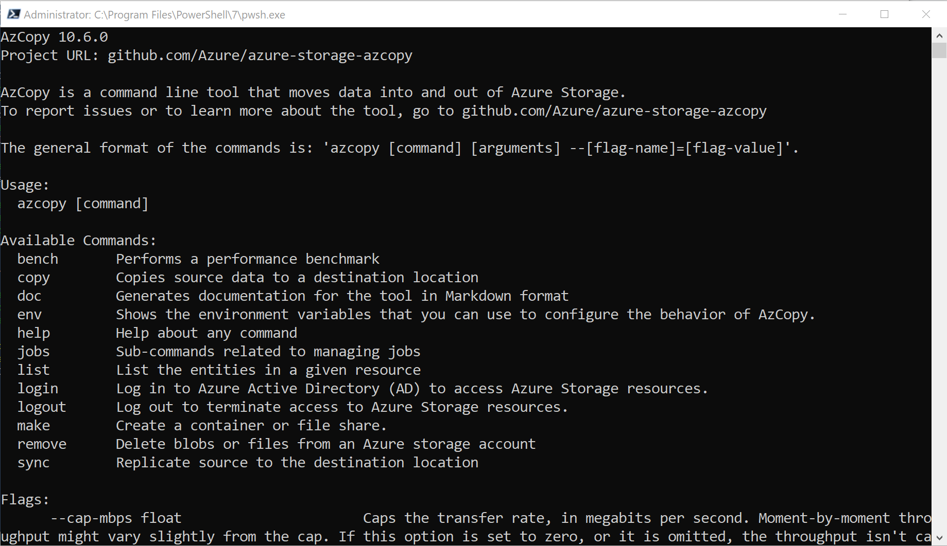
AZCopy Command
Notes:
AzCopy is a command-line utility that you can use to copy blobs or files to or from a storage account.
A download from Microsoft, it is available for install on Windows, Linux, and Mac Os. Each download is a compressed file w/ an executable. It’s recommended you add the location of the executable to your system path so it runs anywhere inside your chosen command line interface.
>AzCopy is also pre-installed in Azure Cloud Shell so you can use it inside cloud shell if you can’t run the tool on a your local system.
Support blobs and files to/from Storage Account
Supported Authentication Methods
https://docs.microsoft.com/en-us/azure/storage/common/storage-use-azcopy-v10

Slide 52
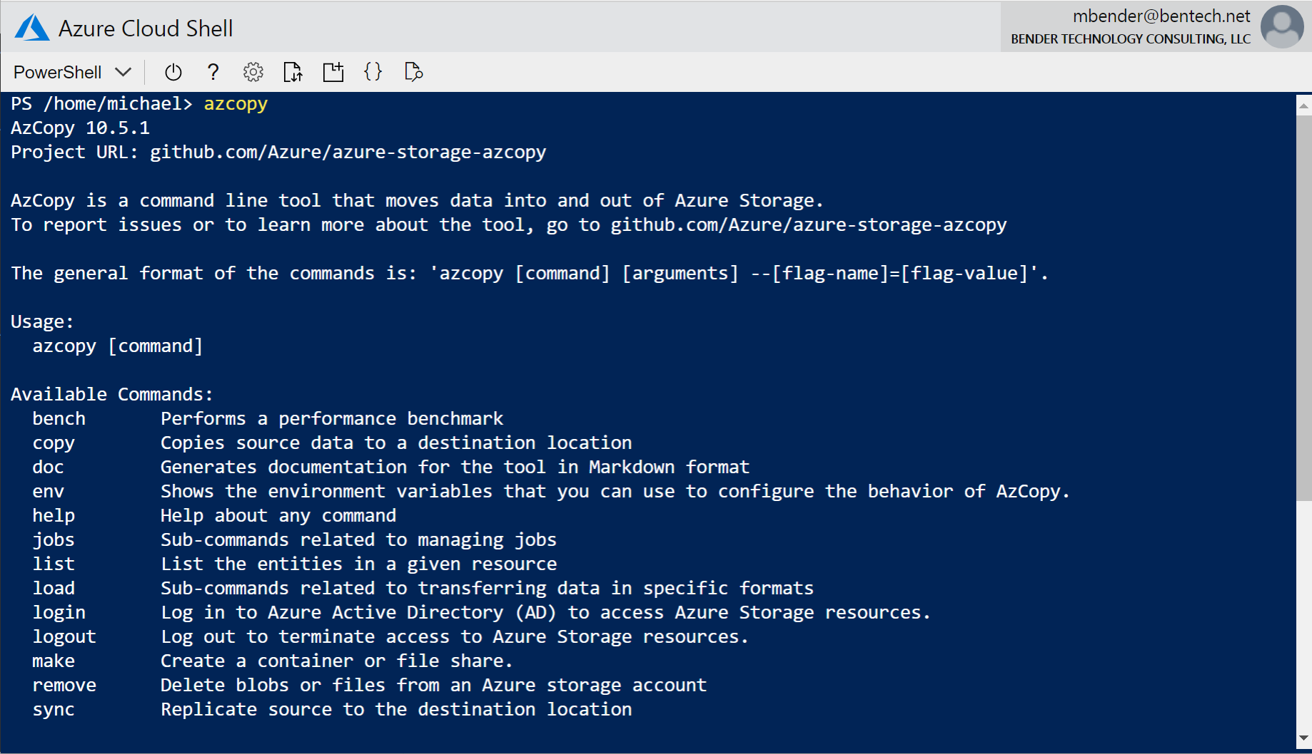
AZCopy Command
Notes:
AzCopy is a command-line utility that you can use to copy blobs or files to or from a storage account.
A download from Microsoft, it is available for install on Windows, Linux, and Mac Os. Each download is a compressed file w/ an executable. It’s recommended you add the location of the executable to your system path so it runs anywhere inside your chosen command line interface.
AzCopy is also pre-installed in Azure Cloud Shell so you can use it inside cloud shell if you can’t run the tool on a your local system.
Support blobs and files to/from Storage Account
Supported Authentication Methods
https://docs.microsoft.com/en-us/azure/storage/common/storage-use-azcopy-v10

Slide 53
AzCopy Syntax
azcopy [command] [arguments]
--[flag-name]=[flag-value]
Notes:
The syntax for AzCopy includes various commands like copy and list
Along with arguments like source file & folders and destination
And like all command line tools you can add flags, some with values, to tell the tool how to run such as --recursive for copy commands to go through sub folders and files.

Slide 54
AzCopy Syntax
azcopy copy 'H:\data' 'https://sablobstore001.blob.core.windows.net/blobdata' --recursive
Notes:
Here you see the azcopy copy command being used to copy data from H:\Data on the local system in the blob container, blobdata, located in the sablobstore001 storage account

Slide 55

Supported Authentication Credentials for AzCopy
BlobStorage
Shared Access Signature (SAS)
Azure AD
Ensure proper roles are assigned
FileStorage
Shared Access Signature (SAS) Only
Ensure proper role assignments
Notes:
To work with your Azure Storage using AzCopy, you need to first authenticate.
For BlobStorage, you can use Shared Access Signatures (SAS) or Azure AD for authentication, depending on use case and how your environment is set up.
With shared access signatures, you’ll copy the SAS URI
In the case of Azure AD, Make sure you have the proper Data Plane and Resource Plane permissions on the account. You need authentication into the storage account objects (aka data plane) and the azure resources (resources plane).
These will be driven by how people need to interact with the data
For FileStorage, your only option is to use a Shared Access Signature.
For all authentication, remember to have the correct data plane and resource plane permissions set. This means assigning the correct user or group roles within Identity Access Management and Azure AD. Check out my course Microsoft Azure Administrator: Managing Storage Accounts for more details on setting proper roles for Azure Storage and storage accounts.

Slide 56
Migrating Data with AZCopy
Install AzCopy
List data in Storage Accounts
Copy data into Storage Account
Copy data between Storage Accounts
Notes:
Now let’s dive into Az Copy. In this demo, you see how to install AzCopy. You’ll learn how to use it for listing storage account data objects, and copying data into and between storage accounts, two common scenarios for administrators.
Demo: Migrating Data with AZCopy
On-Prem server to Blob Container
Files and Folders
https://docs.microsoft.com/en-us/azure/storage/common/storage-use-azcopy-blobs
https://docs.microsoft.com/en-us/azure/storage/common/storage-ref-azcopy-copy
Copy to/from Microsoft Azure Blob, file and table storage
Copy between file system and storage account; between storage accounts
Works for Files and Blobs
Azcopy login

Slide 57
Demo: Using Azure AD Authentication with AzCopy

Slide 58

Azure Storage Explorer
Manage Azure Storage from your Desktop
Authentication based on storage account
Runs on Windows, MacOS, and Linux
Supports multiple subscriptions
Notes:
The final tool for your Azure Storage Toolbox is Azure Storage Exporer.
Downloaded from Microsoft, Azure Storage Explorer allows you to Upload, Download and manage your azure storage objects.
In additional to simply upload & download of data, you can manage storage account authentication, create new blob containers and many other administrative tasks, all from your desktop.
It offers all the same authentication options available for each storage account type.
It runs on Windows, MacOS, and Linux so you can use it from any platform you wish.
One of the benefits of storage explorer is it allows you to access multiple subscriptions. You can even move data between subscriptions.

Slide 59
Install Azure Storage Explorer and connect with AD Azure Account
Notes:
The following demos will get you up to speed on Azure Storage Explorer. In the first demo, you’ll learn how to install Azure Storage Explorer and connect into Azure Storage using an Azure AD Account.
Demo: Install Azure Storage Explorer and connect with Azure Account
Browse to SA https://azure.microsoft.com/en-us/features/storage-explorer/
Login to Storage Explorer with Azure AD Account
Visual Studio Account
Show safilestorage001
Properties of Share
Show sablobstorage001
Show Properties of Container

Slide 60
Create Blobs with Azure Storage Explorer
Notes:
Now, you’ll see how to create blobs in a storage account using azure storage explorer,
Under sablobstorage0001,
Create a new container called data
Upload files from demo folder (file01-03)
Copy files from blobexport to folder
Copy files to existing container in blob
Copy blob container from sablobstorage001 to samsdngpv2001 in different subscription
Clone Blob (?)

Slide 61
Configure SoftDelete and manage snapshots with Azure Storage Explorer
Notes:
Demo: Create a Blob in Azure Storage Explorer
Snapshot
Create snapshot in blobExport
View History and Options
Create Snapshot for fileshare data
View history and options
Configure SoftDelete

Slide 62
Access Azure Storage using Shared Access Signatures and Storage Explorer
Notes:
On sablobstorage001
Show how to set access to Public
Copy URL for webpage - https://sablobstorage0001.blob.core.windows.net/demo/webpage001.html
Show in Browser
Change To Public
Show in Browser
Show how to create shared access signature
Create Read List on blobexport
Copy
Connect to URI
Attempt to Upload

Slide 63
Import Files and Blobs
Export Blobs only
Prep drives with WAImportExportTool
AzCopy supports AzureAD and SAS depending on the target
Use Storage Explorer for management and access items
Review all the Tools!
Summary
Notes:
And that wraps it up for managing data in Azure Storage
As you continue on your AZ-104 journey, there are few key things you’ll need to know for the exam:
When working with the Azure Import/Export Service, remember you can import files and blobs into Azure storage, but only blobs can be exported.
As part of the Import/Export processes, make sure you understand how WAImportExportTool works for preparing drives and working with Bitlocker encryption.
For AzCopy, make sure you understand the supported authentication methods, and be familiar with the basic commands for working with Azure Storage.
Remember that Azure Storage Explorer provides a desktop application for managing many aspects of Azure Storage like authentication, access, and migration.
Depending on when you take the exam, you may or may not have hands on components. That said, you should make sure to run through using AzCopy and Storage Explorer as you may see questions on their use. For WAImportExportTool, reviewing the documentation at docs is a great place to review.

Slide 64
For Further Learning
Check out docs.microsoft.com
Remember the module exercise files!
Microsoft Azure Administrator: Managing Storage Accounts by Michael Bender
Questions? Join on the conversation at pluralsight.com or @Michaelbender on Twitter
Notes:
If you need further learning resources or information about the topics covered in this module, check out the documentation on all of the tools covered in this course at docs.Microsoft.com. These are great resources for Azure Administrators, and will allow you to go deeper into each topic area.
You’ll find many helpful docs and links in the module exercise files on pluralsight.com. Look for the ReadMe file for more information.
Since you are working with Storage accounts with all of these tools, make sure you have watched Microsoft Azure Administrator – Managing Storage Accounts where I run you through everything you need to know about storage accounts.
And if you have any questions about the course, please join the discussion on the discussion board for the course at pluralsight.com.
Now you should have all the knowledge you need to cover this area of the AZ-104 exam focused on managing data in Azure Storage
I hope you enjoyed this course, as I enjoyed putting it together for you.
With that, thanks for watching and I'll see you in another course on Pluralsight.com.

